Slide 1
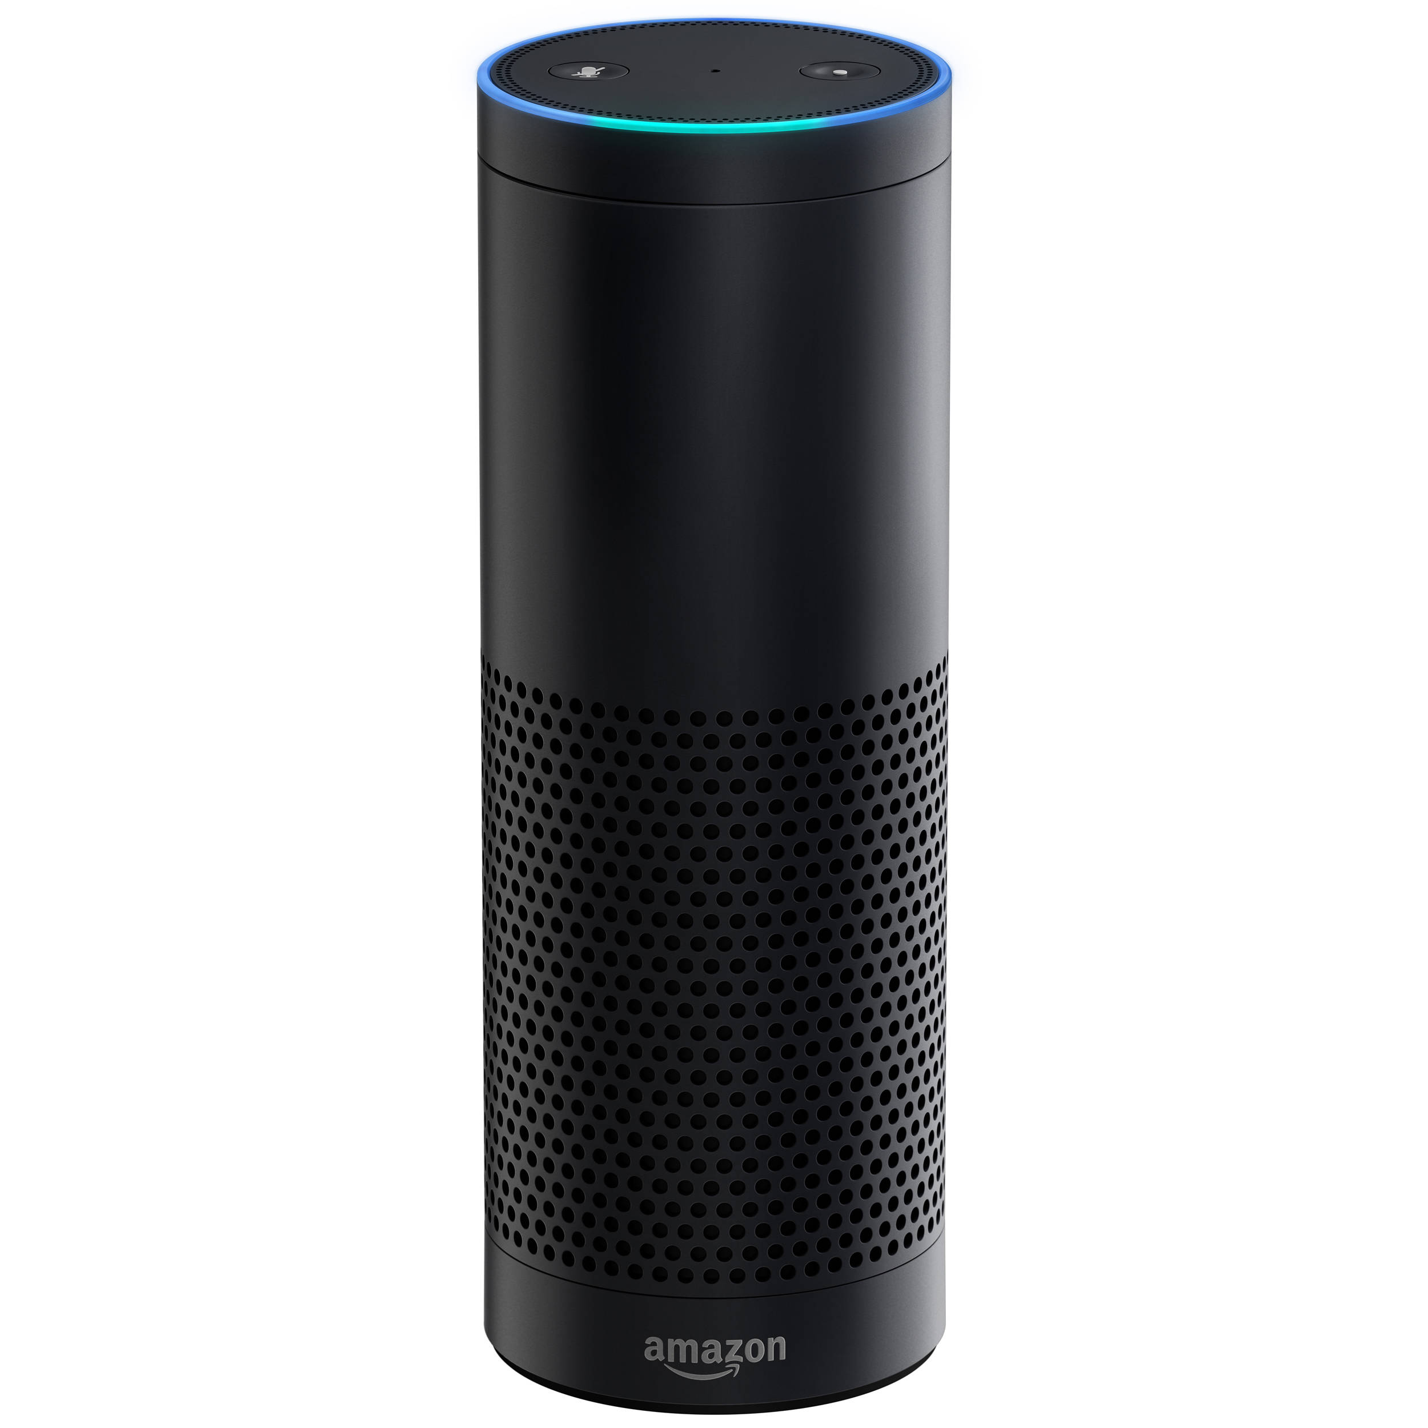
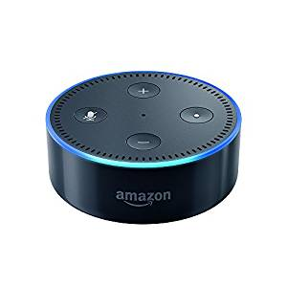
Technologies To Be Used
Hardware:
Amazon Echo / Amazon Echo Dot
Software:
AWS(Amazon Web Services) lambda
TensorFlow
Echosim.io
Amazon Echo
Amazon Echo Dot

Slide 2
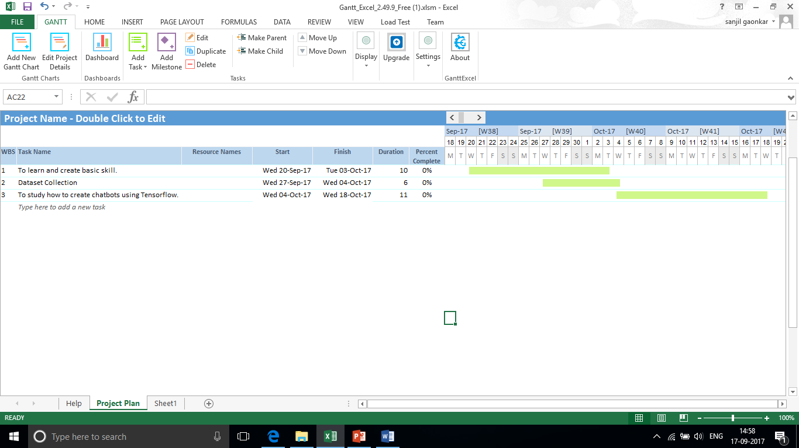
Work to be undertaken from Review 1 to Review 2 :
1
2
3

